Slide 1
MULTI-LAYER PERCEPTRON NEURAL NETWORKS DECODER FOR LDPC CODES
BY PUSHKAR PRAMOD WANI
1PE17EC093
UNDER THE GUIDANCE OF
Prof. Bivas Bhattacharya
Assistant Professor, Dept. of ECE, PESIT-BSC

Slide 2
Abstract
In this paper, a new method for decoding LDPC codes, based on MLP neural networks is proposed.
This method can be considered as a viable alternative to SP Algorithm which involves high computational complexity.
The neural decoder performance is close to the error performance of Sum Product Algorithm (SPA), it is comparatively less complex.

Slide 3
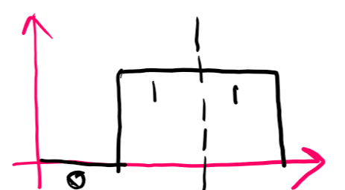
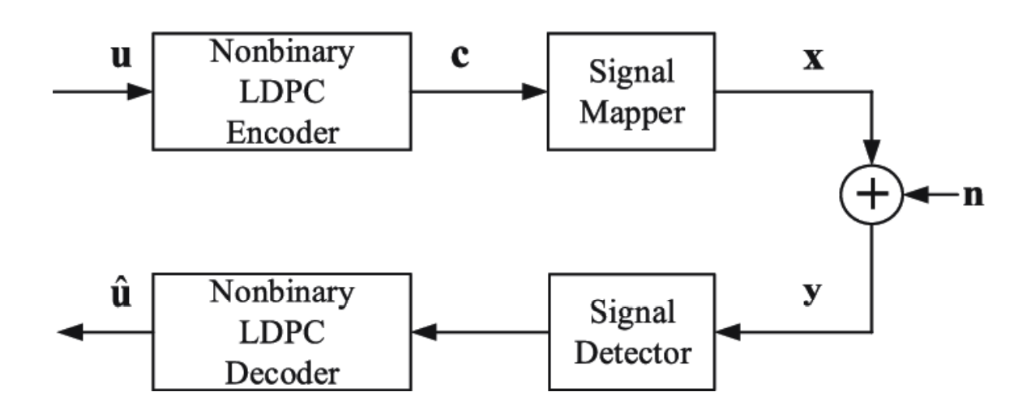
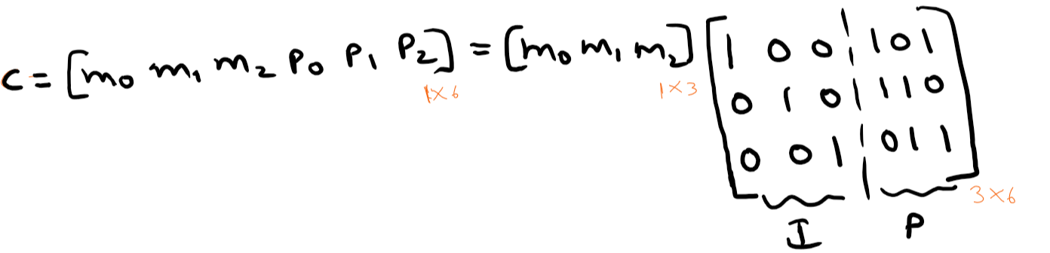


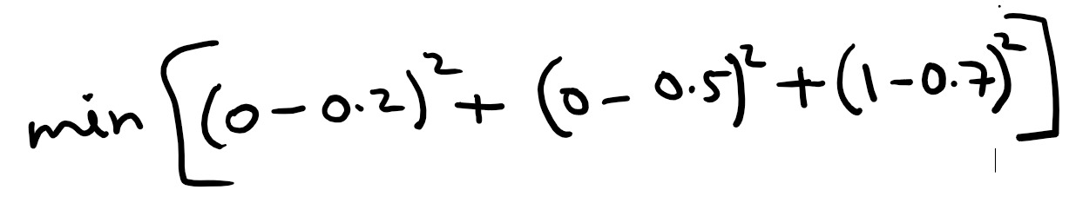

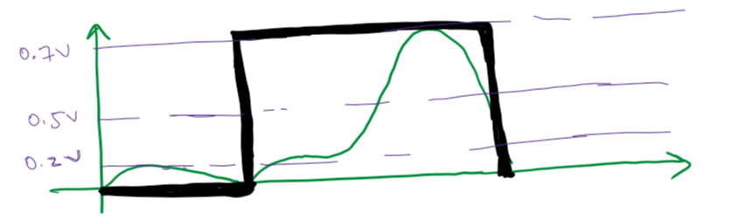

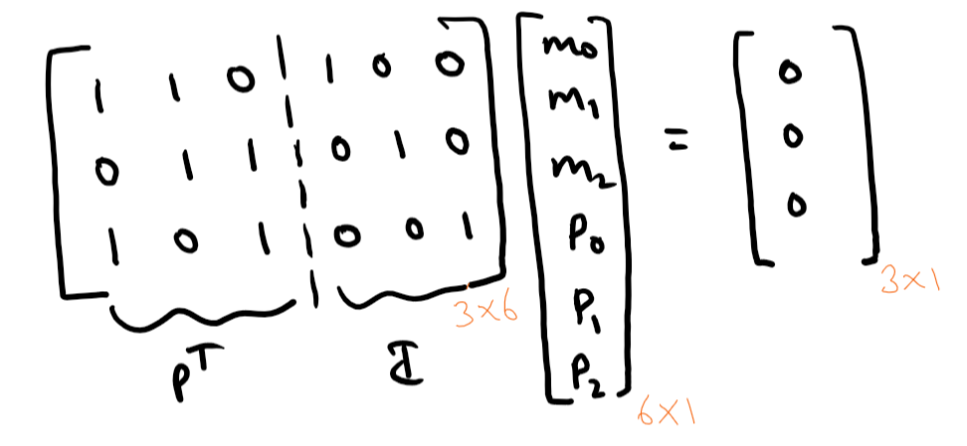



Basics of Communication Channel
Codeword = message * generator

Slide 4
History of Low-Density Parity Check Codes
In 1948 Shannon published his famous paper on the capacity of channels with noise.
In 1963 Gallager introduced LDPC codes, analysed them, and gave some decoding algorithms.
In 1982 Michael Tanner considered Gallager's LDPC codes, and introduced the notion of using bipartite graph called a Tanner graph.
In 1995 David Mackay proved that LDPC codes can essentially achieve Shannon Capacity on AWGN channels.

Slide 5
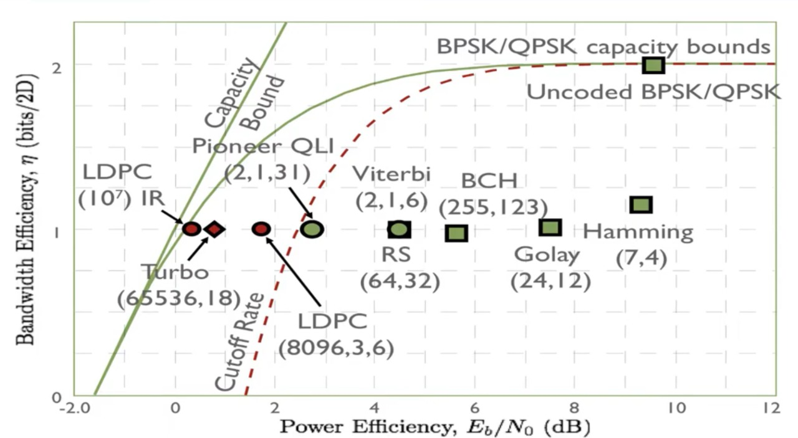
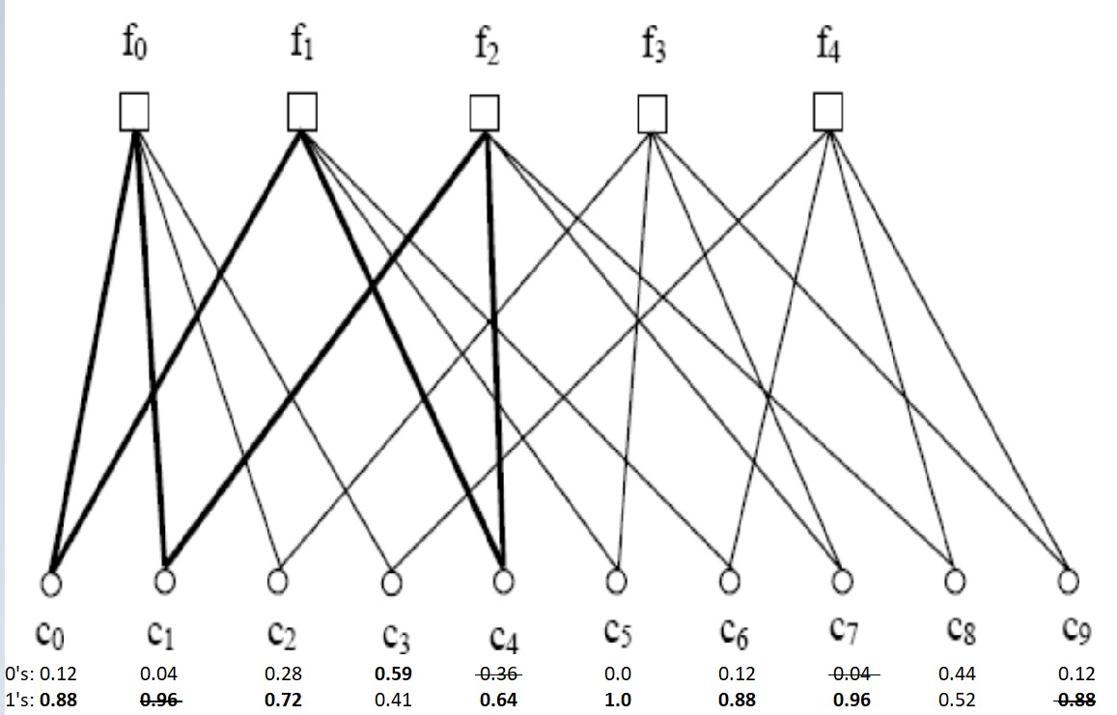
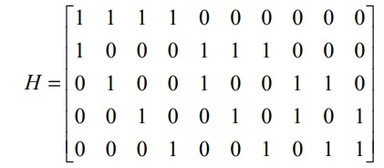
What are LDPC codes?
LDPC codes are considerable because of their near to ideal performance known as Shannon limit.
They are the codes specified by a parity check matrix H, containing mostly 0’s and only a small number of 1’s.

Slide 6
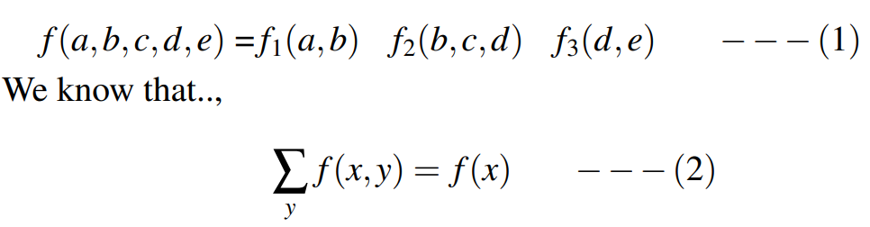
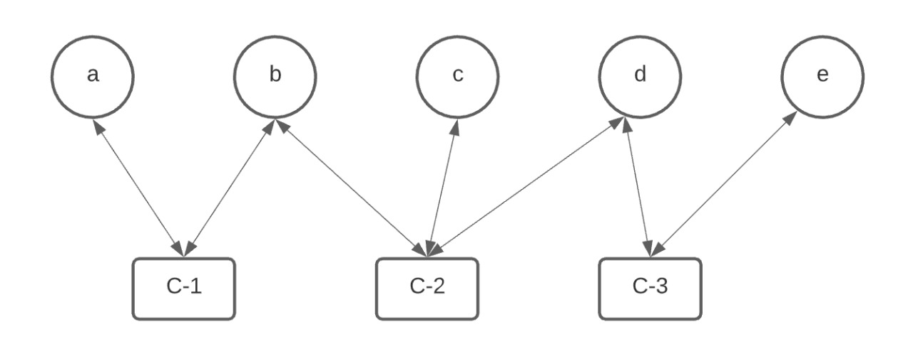
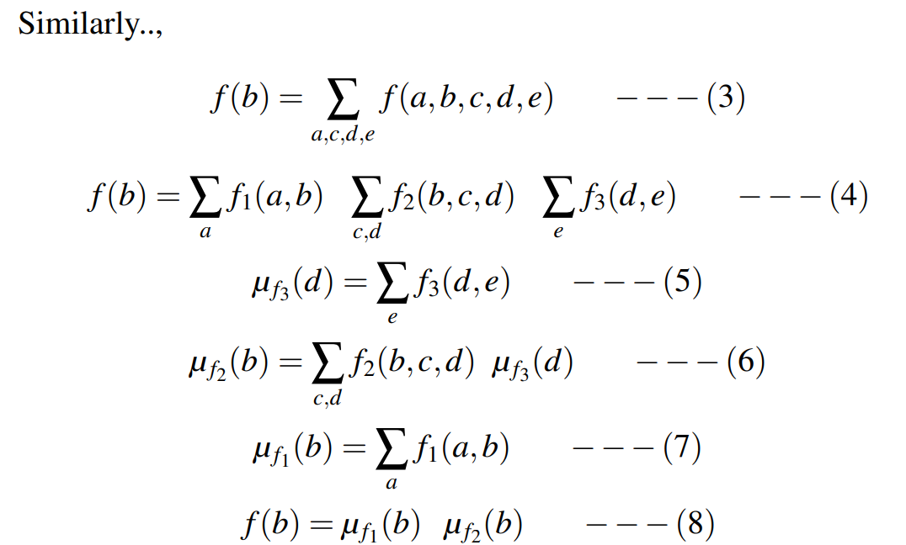
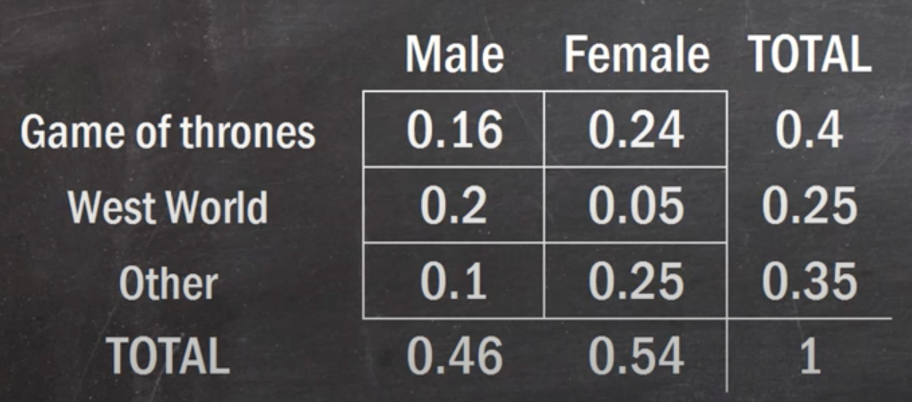
Computational Complexity of Sum Product Algorithm

Slide 7
Decoding LDPC Codes
The graphical display creates a very useful realization for decoding of this code.
There are various decoding techniques involving Hard decision and Soft decision decoding.
Bit flipping
A posteriori decoding
Iterative decoding based on Sum Product Algorithm

Slide 8
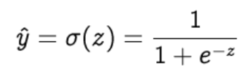
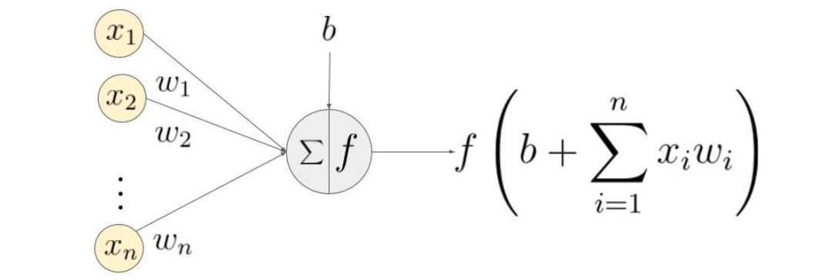
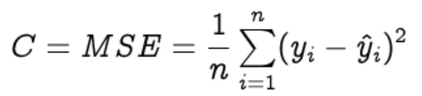
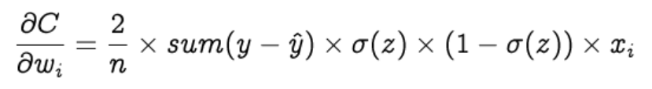
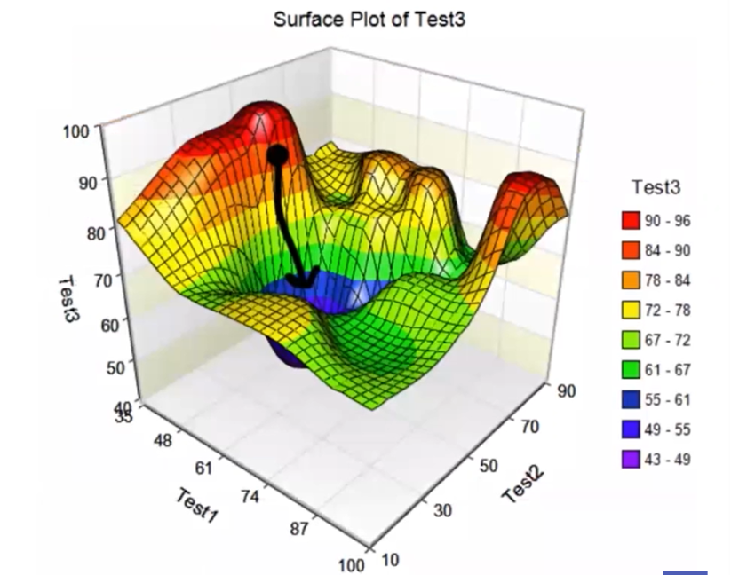

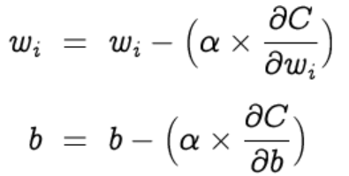
What is a Neural network?

Slide 9

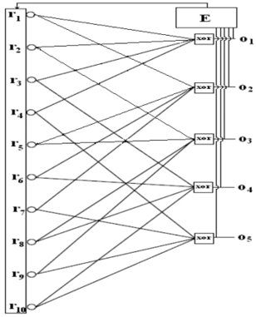

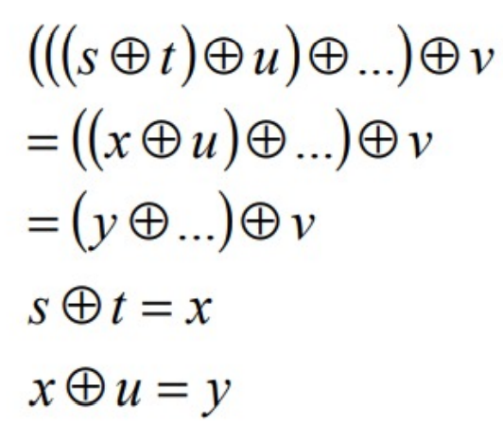
Proposed Neural Network Decoder
The neural decoder is a MLP neural network with two layers. An input layer and an output layer. This network is constructed based on Tanner graph or the parity check matrix of the code.
The network input is actually the received vector from channel ‘r’. This vector is the code word polluted to the additive noise during the channel and may not be a valid code word.

Slide 10
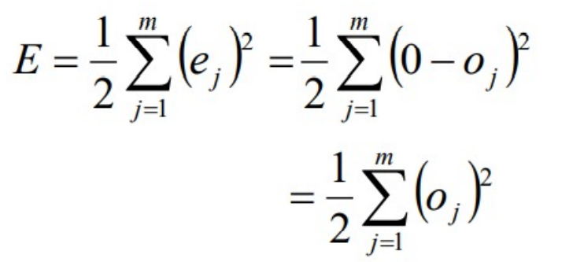
The explained XOR function is differentiable, and so it can be used in the training process of the neural network using gradient descent algorithm.
The network parameters are trained so that O tends to zero.
The SSE function E of the network is as shown below.
The components change as far as the SSE function E approaches its minimum point.

Slide 11
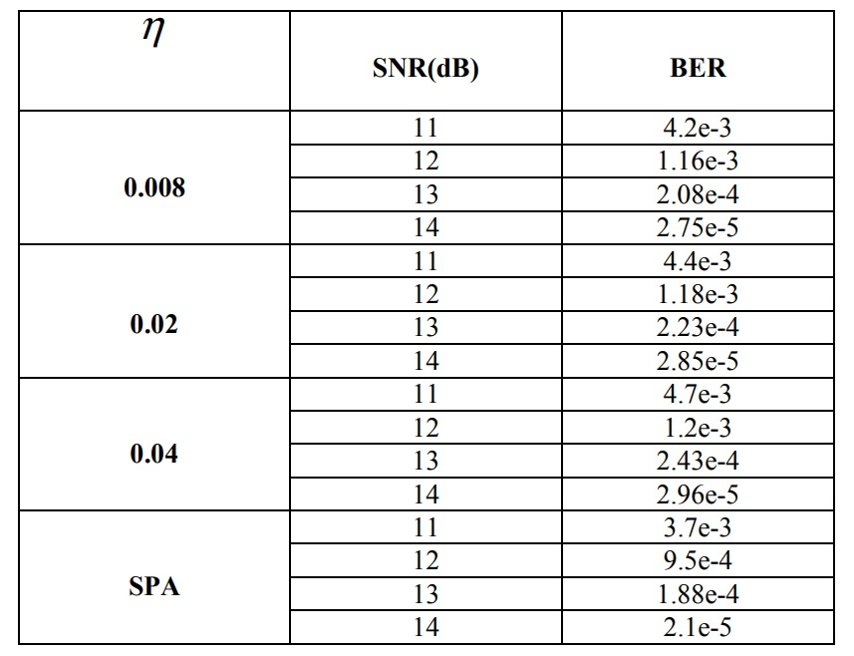
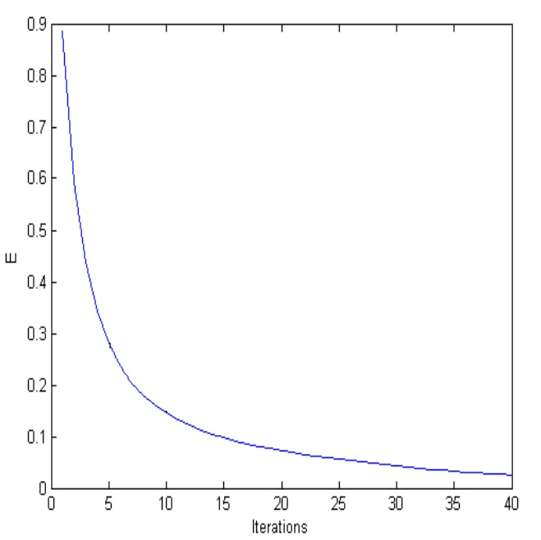
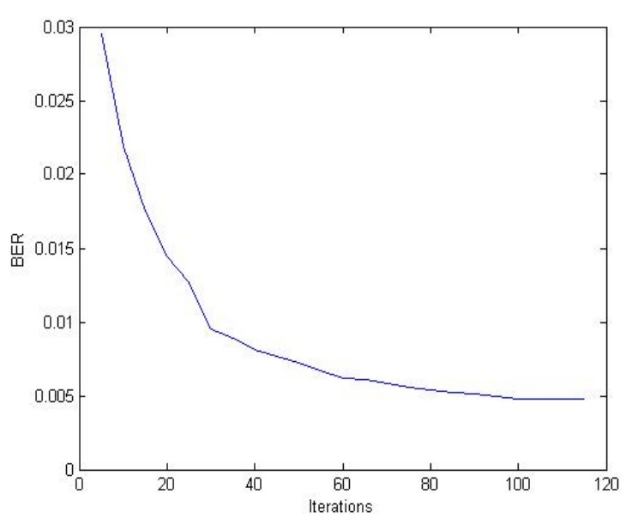
SIMULATION RESULTS

Slide 12
Conclusion
In this paper, a new method of decoding for LDPC codes based on MLP neural networks with decoding process in a soft decision manner is developed. Whereas previous known decoders use probabilistic metrics, MLP based decoder doesn’t need to calculate any probability. It performs a good result with decreased decoding complexity.

